Slide 1

MAP
Gold: 12

Slide 2
MAP

Slide 4
Gold: 12

Slide 5
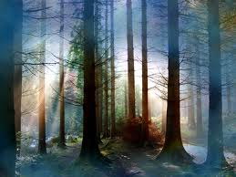
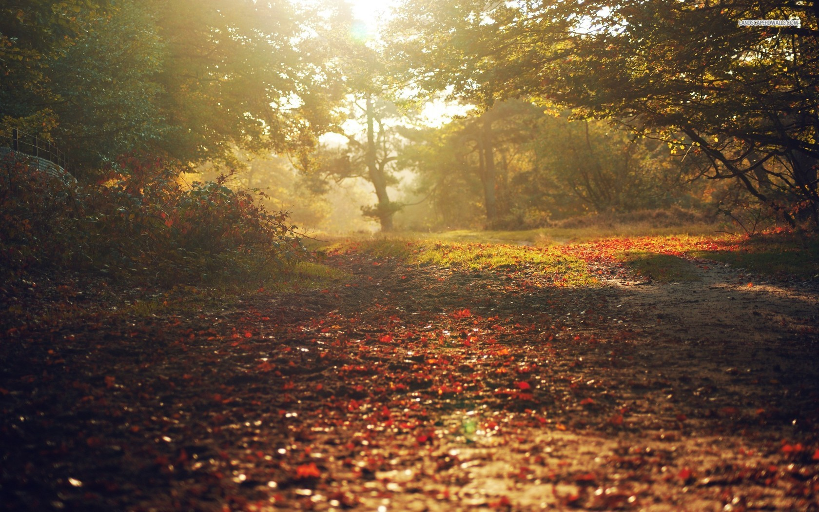
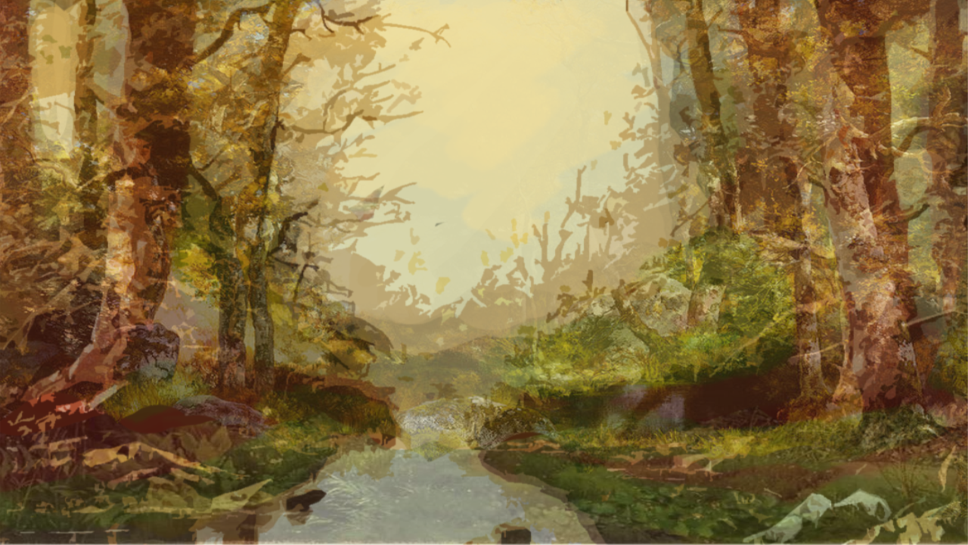
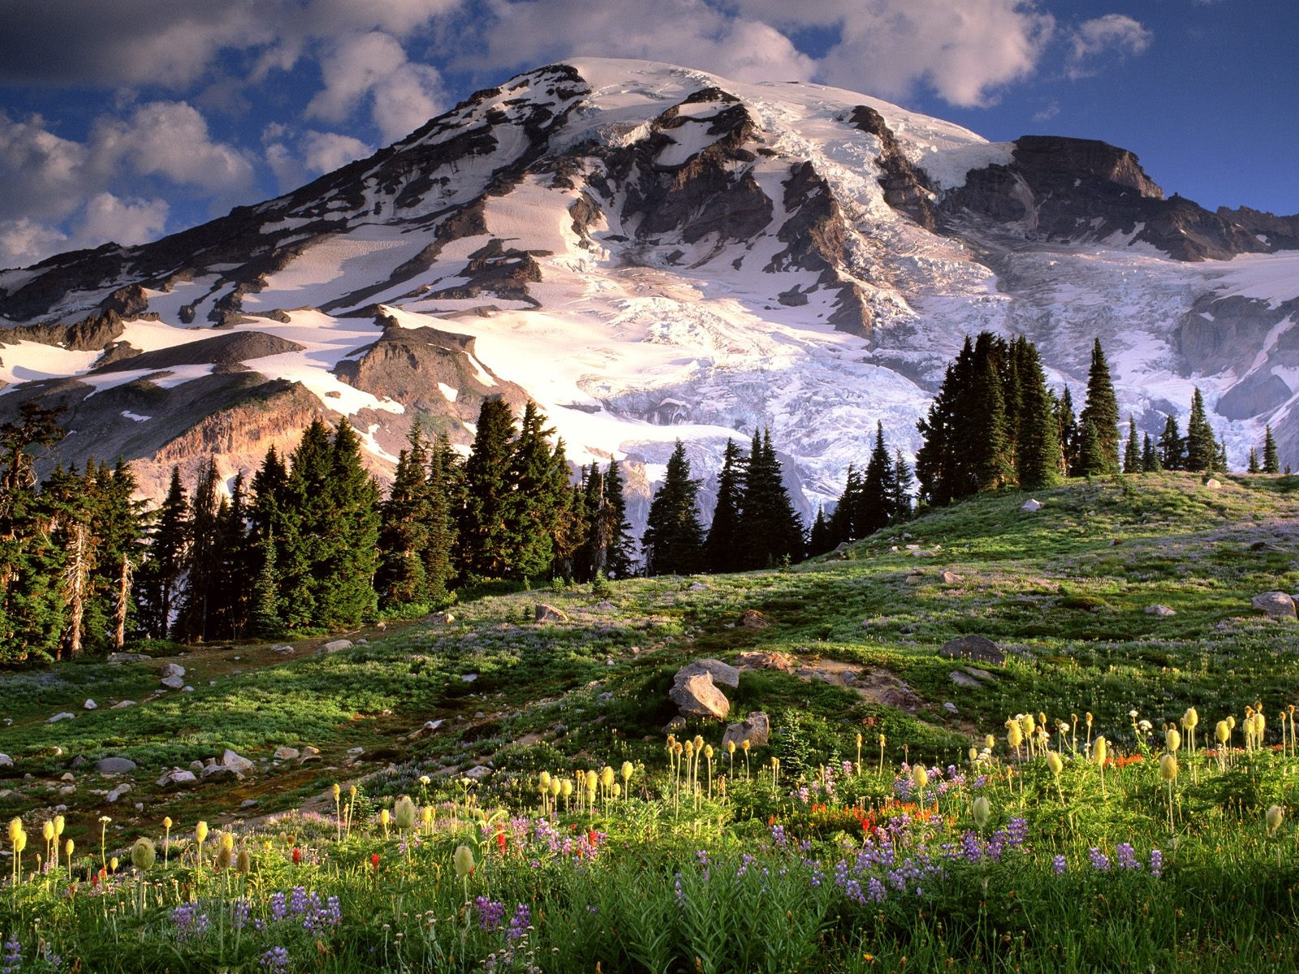

Slide 6
You reach a forest clearing where some shit happens.
1. Run away
2. Cast a spell
3. Take a crap

